Slide 1
Model&function
Keren Zhou
Ruize Xia

Slide 2
1 What is resnet
6 Visualizing The Metrics Curves
2 Why Resnet50
7 Prediction
3 Work Flow
4 Building a Model
5 TRAINING

Slide 3
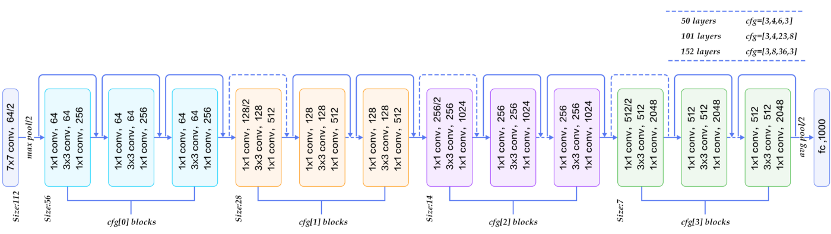
What is resnet
Short for Residual Networks, is a classical convolutional CNN architecture for deep learning.
Composed of residual blocks. Each block contains a shortcut connection that skips one or more layers.

Slide 4
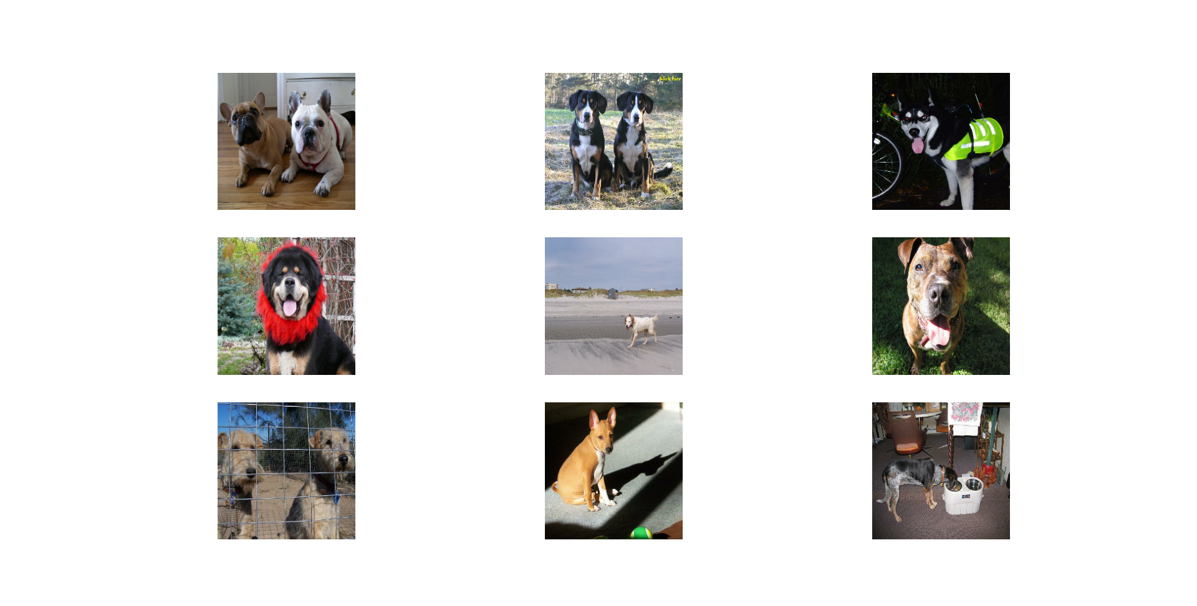
Why Resnet50
Addressing Gradient Issues
Deeper Networks
Alleviating Degradation Issues
Efficient Model Training
Transfer Learning
Widespread Applicability

Slide 5
Work flow
Building a Model
Visualizing The Metrics Curves
Fetching Data
Training
Prediction

Slide 6
Building a Model
Rescaling Layer
Pre-trained Model
Dense Layer
Adam Optimizer

Slide 7
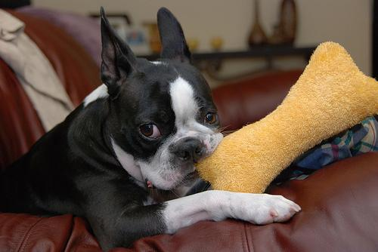
TRAINING
We will add 3 Very Important Callbacks for our model
ModelCheckpoint: This callback saves the model weights after every epoch if the validation loss improves.
EarlyStopping: This callback stops the training process if the validation loss doesn't improve for a certain number of epochs.
ReduceLROnPlateu: This callback monitors a quantity and if no improvement is seen for a 'patience' number of epochs, the learning rate is reduced.

Slide 8
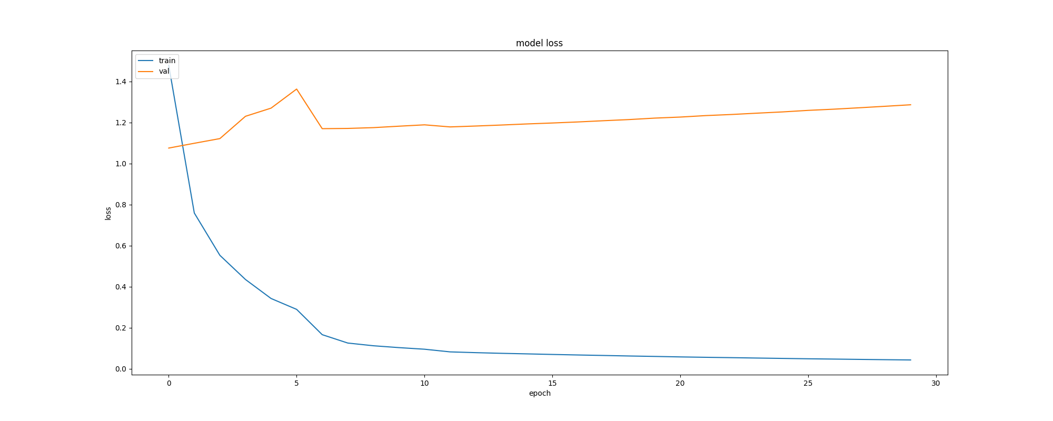
Visualizing The Metrics Curves
After the cross-validation, we can see……

Slide 9
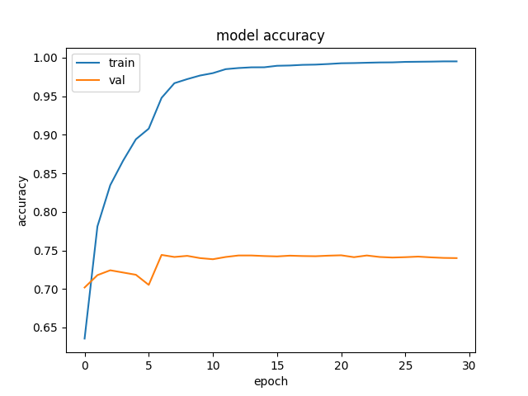
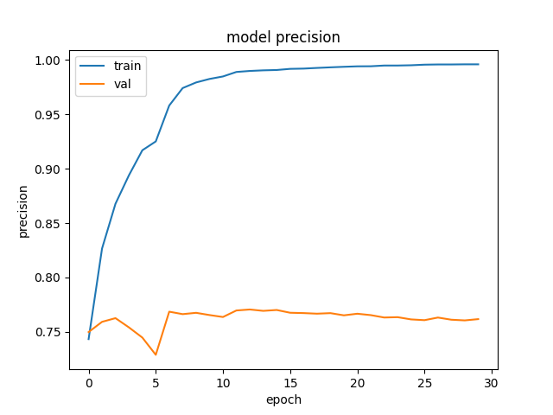
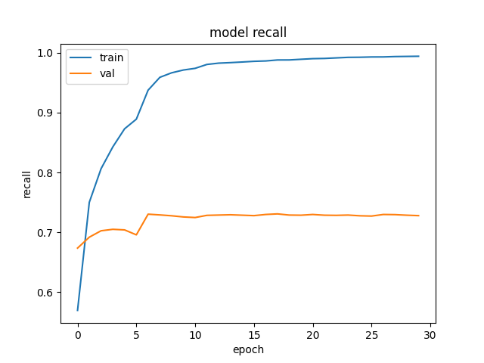

Visualizing The Metrics Curves

Slide 10

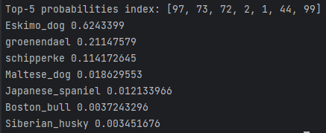
Prediction

Slide 11
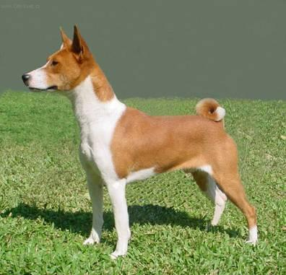
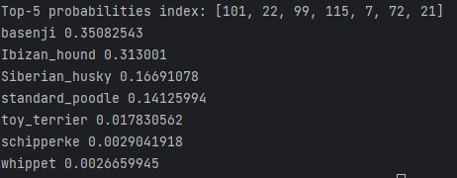
Prediction

